Slide 1
Fiber Optics Elementary discussion…..

Slide 2
OPTICAL FIBER COMMUNICATION
Fiber-optic communication is a method of transmitting information from one place to another by sending pulses of light through an optical fiber.
The light forms an electromagnetic carrier wave that is modulated to carry information.
Fiber is preferred over electrical cabling when high bandwidth, long distance, or immunity to electromagnetic interference are required.
This type of communication can transmit voice, video, and telemetry through local area networks, or across long distances.

Slide 3
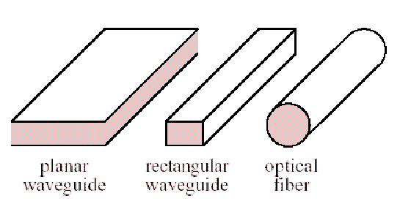
What it does….
An optical wave guide is a structure that "guides" a light wave by constraining it to travel along a certain desired path.
Light can be guided by planar or rectangular wave guides, or by optical fibers

Slide 4
Optical fibers are made from either glass or plastic.
Most have roughly the diameter of a human hair, and they can be many miles long and Light is transmitted along the center of the fiber from one end to the other
Fiber optic systems are superior to metallic conductors due to the fact of Extremely high bandwidth (mainly). Because of the wavelength of light, it is possible to transmit a signal that contains considerably more information than a metallic conductor.

Slide 5
Advantages….
Extremely High Bandwidth
Electrical Isolation — Fiber optics do not need a grounding connection. Both the transmitter and the receiver are isolated from each other and are therefore free of ground loop problems. Also, there is no danger of sparks or electrical shock.
Freedom from EMI — Fiber optics are immune to electromagnetic interference (EMI), and they emit no radiation themselves to cause other interference.

Slide 6
Lighter and Smaller — Fiber weights less and needs less space than metallic conductors. Ex: Copper wire is about 13 times heavier.
Low Security Risk: Data or signals are transmitted via light, therefore there is no way to detect the data being transmitted by listening in to the electromagnetic energy leaking through the cable, which ensures the absolute security of information.

Slide 7
Applications….
Medical: Used as light guides, imaging tools and also as lasers for surgeries
Defence/Government: Used as hydrophones for seismic waves and SONAR , as wiring in aircraft, submarines and other vehicles
Used for data transmission
Telecommunications: Fiber is laid and used for transmitting and receiving purposes
Networking: Used to connect users and servers in a variety of network settings and help increase the speed and accuracy of data transmission
Broadcast/CATV: Broadcast/cable companies are using fiber optic cables for wiring CATV, HDTV, internet and other applications
Fiber optic cables are used for lighting and imaging and as sensors to measure and monitor a vast array of variables.
Fiber optic cables are also used in research and development and testing across all the above mentioned industries

Slide 8
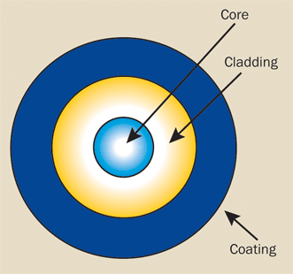
Structure
An optical fiber consists of three basic concentric elements: the core, the cladding, and the outer coating
The core is usually made of glass or plastic.The core is the light-transmitting portion of the fiber.
The cladding usually is made of the same material as the core, but with a slightly lower index of refraction (usually about 1% lower). This index difference causes total internal reflection to occur at the index boundary along the length of the fiber so that the light is transmitted down the fiber and does not escape through the sidewalls.
The coating usually comprises one or more coats of a plastic material to protect the fiber from the physical environment.
Notes:
*although other materials are sometimes used, depending on the transmission spectrum desired.

Slide 9
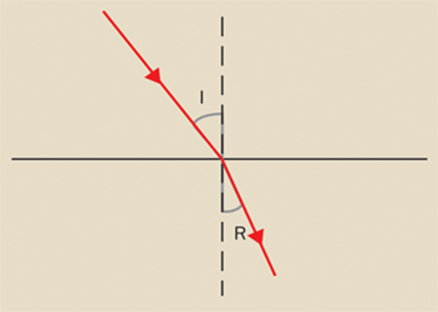
Process of Transmission….
Light injected into the fiber optic core and striking the core-to-cladding interface at an angle greater than the critical angle (typically about 82° for optical fibers) is reflected back into the core; a process known as total internal reflection .
Since the angles of incidence and reflection are equal, the light ray continues to zigzag down the length of the fiber. The light is trapped within the core.

Slide 10
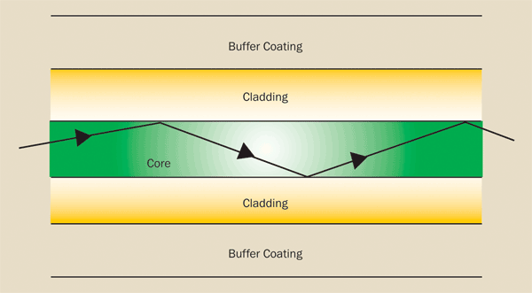
Light striking the interface at less than the critical angle passes into the cladding and is lost.

Slide 11
Fiber types
They are characterized by the way light travels down the fiber and depend on both the wavelength of the light and the mechanical geometry of the fiber.
There are basically three types of optical fiber:
single mode
multimode step-index
multimode graded index
The core in a graded-index fiber has an index of refraction that radially decreases continuously from the center to the cladding interface. As a result, the light travels faster at the edge of the core than in the center. Different modes travel in curved paths with nearly equal travel times.

Slide 12
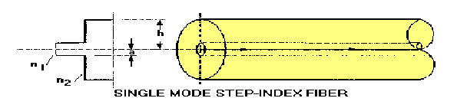
Single mode
The light beam travels straight through the fiber with no reflections from the core-cladding sidewalls at all.
A single mode fiber only allows light to propagate down its center and there are no longer different velocities for different modes.
A single mode fiber is much thinner than a multimode fiber
Typical core diameters are between 5 mm and 10 mm.

Slide 13
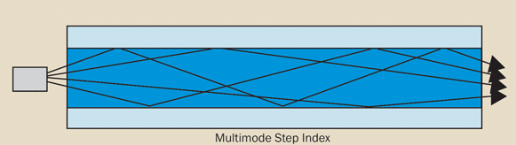

Multimode step-index
trap light with many different entrance angles where each mode is associated with a different entrance angle.
Each mode therefore travels along a different path through the fiber. Showing different velocities
Thus the pulse begins to spread. Pulses that enter well separated from each other will eventually overlap each other which limits the distance over which the fiber can transport data.
Multimode step-index fibers are not well suited for data transport and communications.
core diameters of 100 mm to 1000 mm

Slide 14
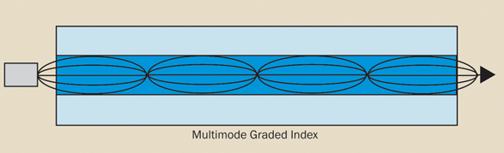
Multimode graded-index
The core diameters of multimode fibers are much larger than single-mode fibers.
the core has an index of refraction that decreases as the radial distance from the center of the core increases.
So light travels faster near the edge of the core than near the center.
Different modes therefore travel in curved paths with nearly equal travel times reducing the spreading of optical pulses.

Slide 15
Disadvantages of Fiber Optic Transmission
Fragility: usually optical fiber cables are made of glass, which lends to they are more fragile than electrical wires. In addition, glass can be affected by various chemicals including hydrogen gas (a problem in underwater cables).
Difficult to Install: it’s not easy to splice fiber optic cable. And if we bend them too much, they will break. And fiber cable is highly susceptible to becoming cut or damaged during installation or construction activities. All these make it difficult to install.
Attenuation & Dispersion: as transmission distance getting longer, light will be attenuated and dispersed
Cost is higher than copper cable

